Slide 1

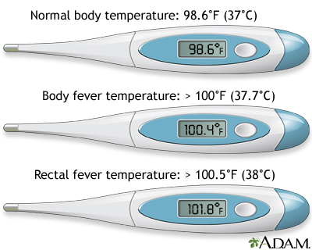
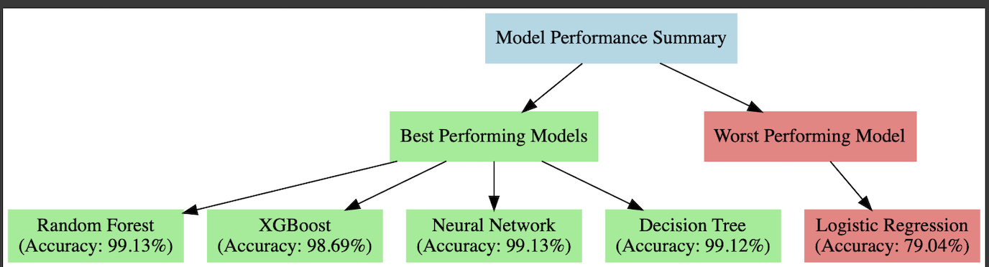
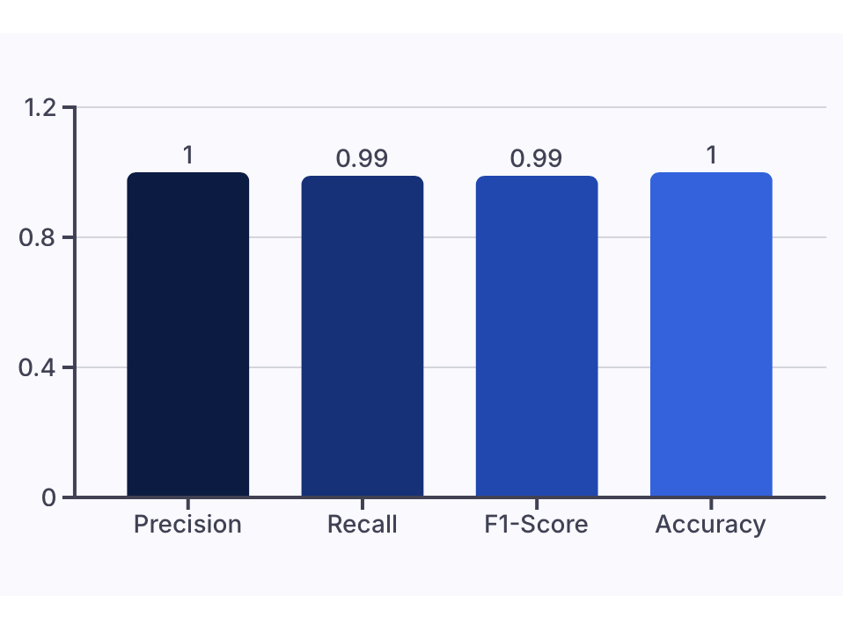
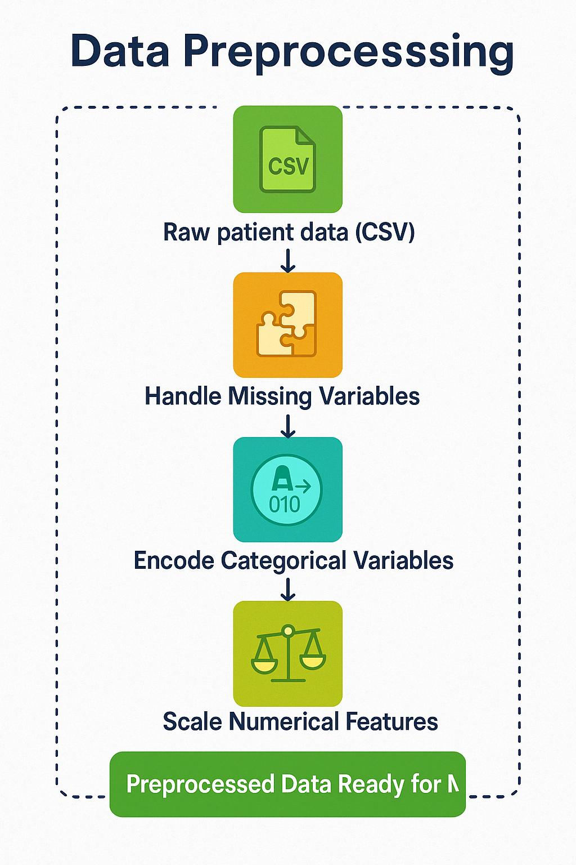
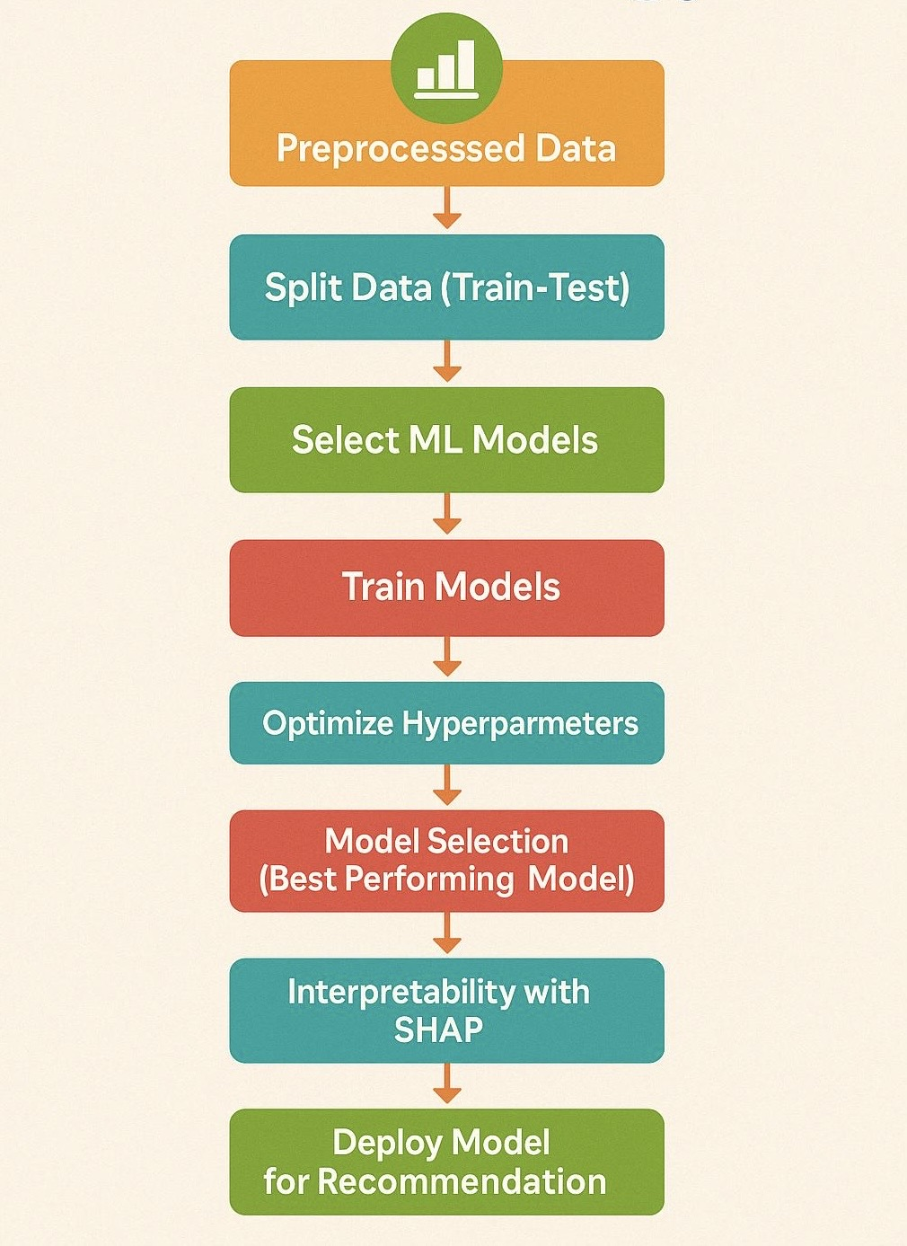
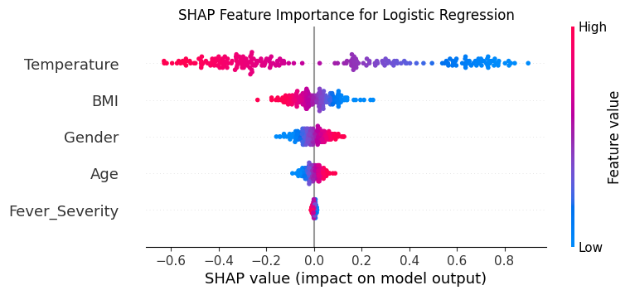
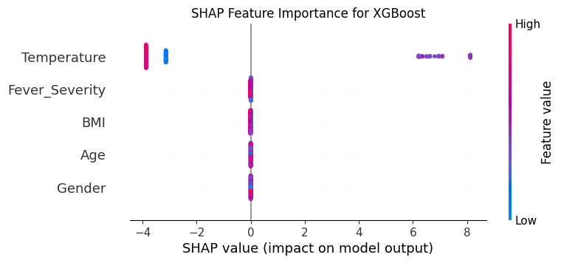

Precision Medicine for Fever Medication Recommendation Using Machine Learning
Instructor: Dr. Amna Mazen
Syllas Otutey, Miltone Awiti, Gideon Owusu, Frank Ofosu
Department of Applied Computing.
Introduction
Research Objectives
Experiment and Result
Research Gap:
Traditional fever treatments ignore personalized factors highlighting the need for ML recommended medications
Proposed Solution:
Personalized Algorithms
Personalized Treatments
Real-Time Monitoring:
Collaborations with Healthcare Providers:
Evaluation Metrics for Random Forest (RF)
Background
Fig.1: Fever readings
Traditional fever treatment relies on general guidelines, while machine learning can improve precision medicine by analyzing individual patient data to provide more personalized and effective treatment recommendations.
Methodology
ML Process
Fig.5 Model Performance Summary
Fig.7 :Random Forest Results
Research question
How can machine learning (ML) models be utilized to recommend personalized treatment options for fever based on individual patient data
Interpretability WITH SHAP (Explainable AI)
Fig.7: SHAP for R F & Logistic Regression
Conclusion
The paper shows how machine learning enhances personalized fever treatment by analyzing patient-specific data, outperforming traditional methods. Ensemble models like Random Forest, XGBoost and Neural Network provide the best accuracy, while logistic regression underperforms. Interpretability methods ensure transparency in AI-driven healthcare. This approach improves patient outcomes and optimizes medical care.
Fig.2: Research Question
Fig.3: Data Preprocessing flowchart
Fig.4 machine Learning Model

